Slide 1

Accurate PREDICTION of BOUNDING BOXES in OBJECT DETECTION
ECE570 FINAL PROJECT
NAME – SOURADIP PAL
PUID - 0034772329

Slide 2
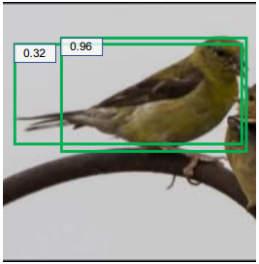
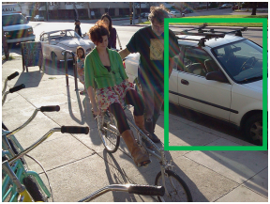
Introduction
Current challenges in Object Localization
Various ambiguities in ground-truth bounding boxes
Incorrect labelling in large-scale object detection datasets e.g. MS-COCO
Objects might be occluded and object boundaries might not be visible
Traditional object detectors use Smooth-L1 Loss which is not always suitable
High classification score does not always mean accurate bounding box regression
Localization uncertainties not captured by the object detection model

Slide 3
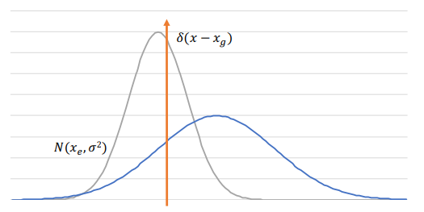
Problem Statement
Use KL-Loss for Bounding Box Regression based on the paper “Bounding Box Regression with Uncertainty for Accurate Object Detection” (He et. al.)
Predicted bounding box coordinates modelled as Gaussian distribution
Ground-truth bounding box coordinates modelled as Dirac-delta functions
Use predicted localization variance in computing box regression loss
Select better box detections using “Variance-voting” like Soft-NMS

Slide 4
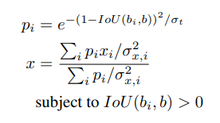
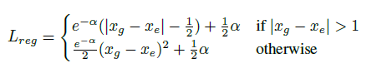
Algorithms
KL-Loss
Variance Voting
Calculate the KL Divergence between the Gaussian and Delta distributions
If variance is 1, KL-Loss becomes similar to Smooth-L1 Loss
KL-Loss depends on α = log(σ²) where σ² is the variance. Network predicts α.
Assign weights to detections such that ones with larger IoU gets higher score
Lower localization variance gets higher voting score
Does not depend on classification score as higher classification does not necessarily mean higher localization confidence

Slide 5
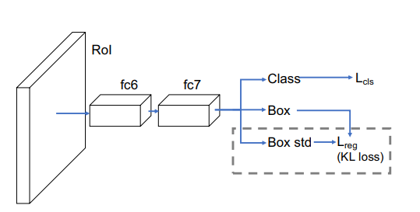
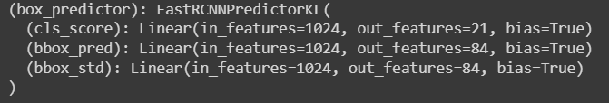
Implementation
KL-Loss and Var-Voting implemented in Pytorch. Original implementation in Caffe2 using Detectron.
Used Faster-RCNN Resnet-50-FPN backbone model pretrained on MS-COCO dataset
Modified architecture to predict box localization variance
Incorporated KL-Loss and Var-Voting algorithms
Trained and validated on PASCAL-VOC(2007) dataset
Compared with existing implementation based on “mAP” (mean average precision)

Slide 6
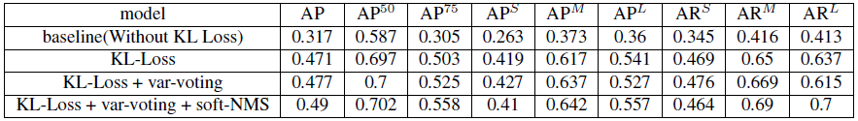
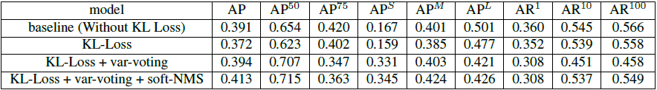
Results
Experiments performed on PASCAL-VOC dataset
Experimented with existing implementation(MMDetection) using MS-COCO data
Experimented with custom implementation using PASCAL-VOC data
Conducted ablation experiments by switching on/off var-voting and soft-NMS
Results close to original paper though lesser than expected
Did not perform well in detecting smaller objects. Low AP^{S} value.

Slide 7
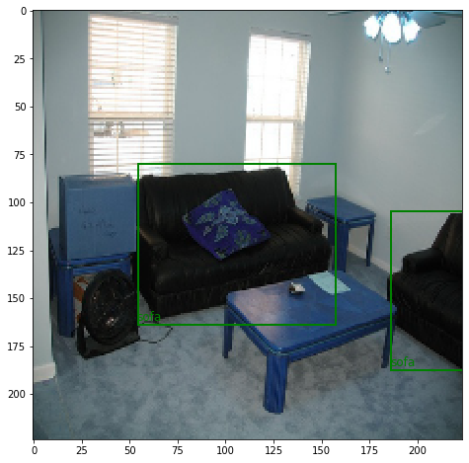
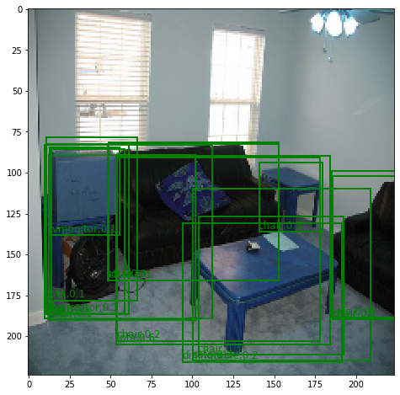
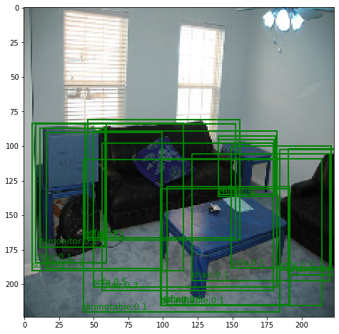
Ground truth boxes in a PASCAL-VOC image
Detections without KL Loss
Detections with KL Loss

Slide 8
Future Work
Improvements on top of the current work
Can be tested using other backbone models like VGG-16
Can be trained using more GPU resources and longer time
Larger datasets like MS-COCO can be used for better results
Can be included into Detectron2 framework via configuration
Better probabilistic approaches to model localization variances

Slide 9
Thank You
References
https://openaccess.thecvf.com/content_CVPR_2019/papers/He_Bounding_Box_Regression_With_Uncertainty_for_Accurate_Object_Detection_CVPR_2019_paper.pdf
https://openaccess.thecvf.com/content_ICCV_2017/papers/Bodla_Soft-NMS_--_Improving_ICCV_2017_paper.pdf
http://host.robots.ox.ac.uk/pascal/VOC/
https://cocodataset.org/#home
https://github.com/chongruo/tiny-coco
https://github.com/facebookresearch/detectron2
https://github.com/yihui-he/KL-Loss
https://github.com/yihui-he/Stronger-yolo-pytorch
https://github.com/cxliu0/KL-Loss-pytorch

